Slide 1
Detecting Eating Activities using Machine Learning Algorithms
Duke Biomedical Engineering M.S. Final
Pooja Parameswaran
Mentor: Jessilyn Dunn Ph.D.
Notes:
Hi my name is Pooja parameswaran, and I am going to be presenting the eating detection algorithm I created with the big ideas lab with pHD student Lucy Chikwetu and Dr. Jessilyn Dunn

Slide 2
Overview
Project Description
Approach
Results
Conclusions
Notes:
NOTECARDS
PROJECT DESCRIPTION
Problem Description
Problem Solution
APPROACH
About the DataseT
Cross Validation
Sliding Window
Feature Engineering
Machine Learning Models
CONCLUSIONS
Predictive Models
Support Vector Machine
Random Forest
Multilayer Perceptron

Slide 3

Problem Description
Currently meal-tracking apps send scheduled alerts to input our meal log
User’s eating instances change daily
Tracking eating habits can be crucial for individuals with certain diagnoses
Notes:
Depends on user’s memory and dedication to recording eating habits
Lab and published studies show manual input into nutrition apps are not consistent
Studies are currently occurring which depend on consistent user input of their eating habits

Slide 4
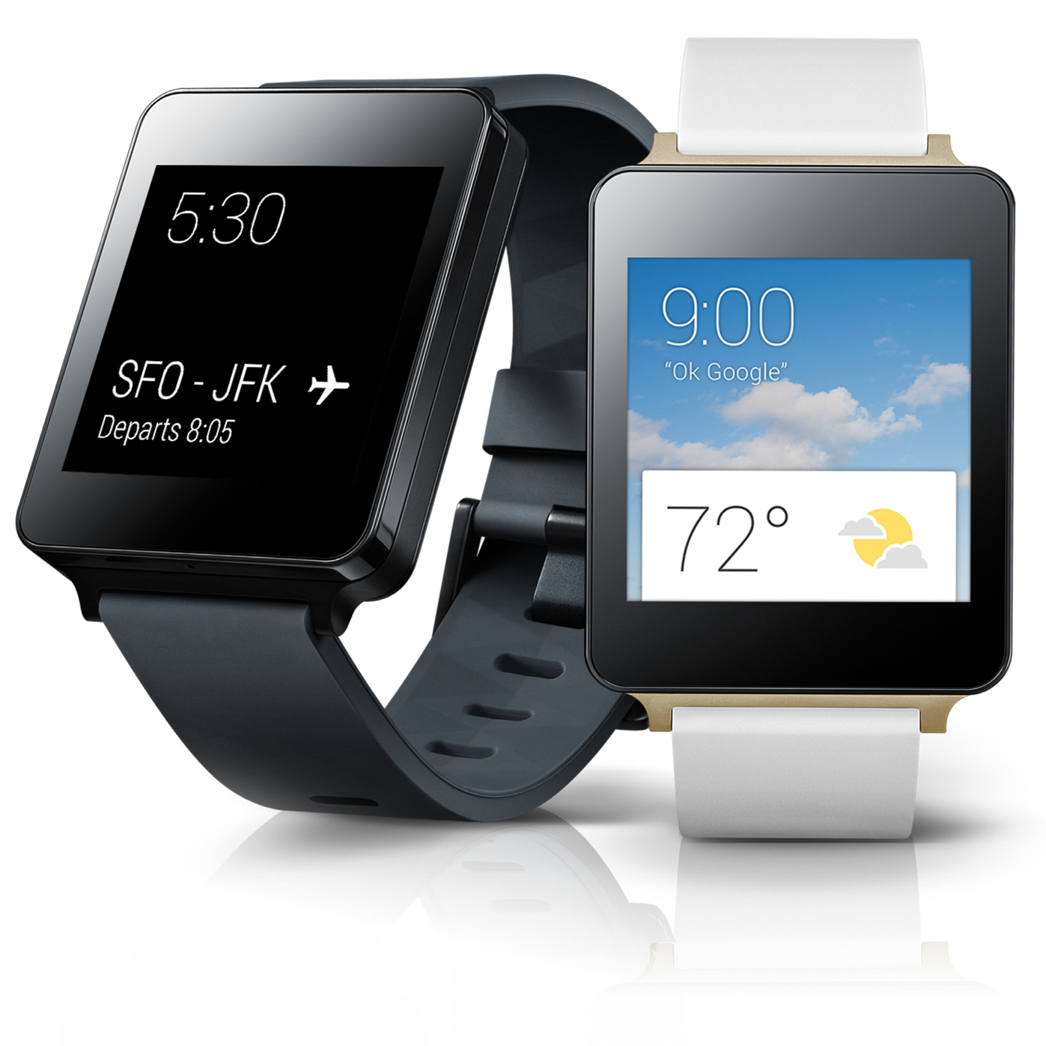
Proposed Solution
We propose an alternative method to alert users to input their eating activity
Detect eating activities from user’s motion data, and alert them to log meal/snack
Construct an algorithm that uses velocity data to detect eating actions from all other actions
Implement algorithm into a device with a motion tracker
Notes:
vThis application paired with a smart watch can be given to participants and patients by scientists and doctors respectively to help track eating habits

Slide 5
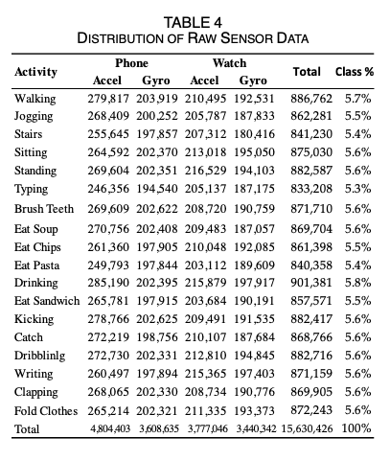
About the Dataset –Wireless Sensor Data Mining Lab at Fordham University
Time Series Data
Allows us to classify activities as a function of time and ultimately make predictions about data
WISDM Dataset
Gathered in October 2019
Dataset from Fordham University providing accelerometer data with a label on what activity is occurring at that point in space and time
Accelerometer data measures velocity along the x, y, and z axes
Measurements taken at a sampling rate of 20 hz
Total of 51 test subjects, 18 activities, 3 minutes each activity occurring
5 eating activities
Binary classification algorithm
0
1
Notes:
Time data can be infinite- algorithms work harder as dataset increases exponentially
Data being observed over consistent intervals to track change
All data points contain a class, timestamp, and data descriptors
Features

Slide 6
Approach - Pipeline
Support Vector Machine
Input
Data
Cross Validation
Sliding Window
Feature Engineering
Random Forest
Logistic Regression
The classification task is to detect the motion of eating activities from all actions

Slide 7
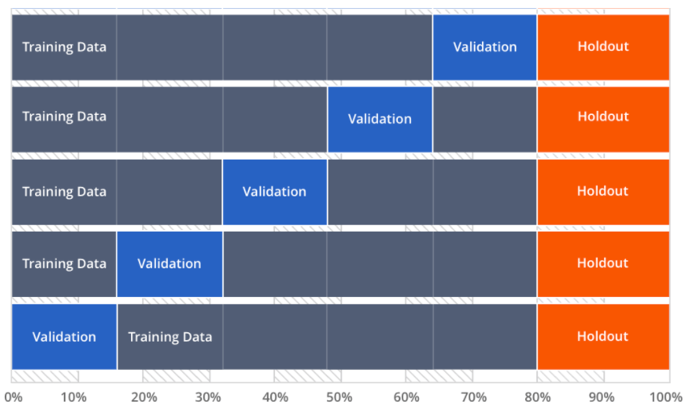
Cross Validation
Time Series data can be sequenced in a biased manner
Cross Validation allows the whole dataset to be split k number of times, making a different portion of the data training and testing sets.
Allows model to get trained on all data points

Slide 8
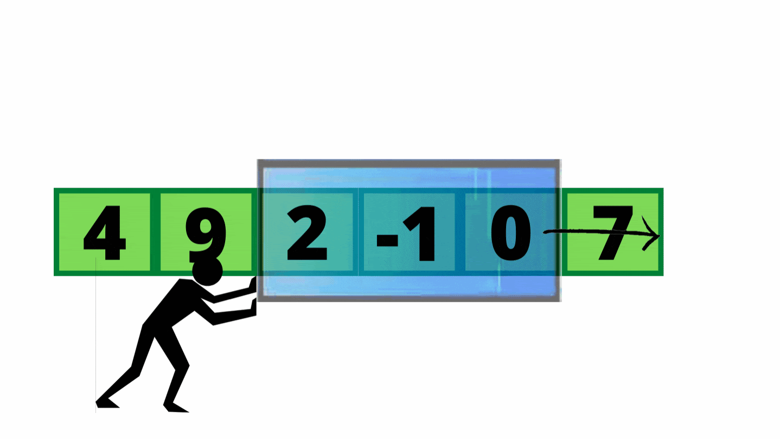
Sliding Window
In time series data, it is imperative we section the data to signify time being represented
With motion, we look at patterns in the data
Each window contains a sectioned amount of time
5 seconds, 10 seconds
Reduces complexity of algorithm
Notes:
Instead of each data point being predicted on, a window of data is predicted on to yield output
Subsets of data are concatenated to a new dataframe
With a watch reading at 20 hz, we hypothesize 5 seconds or 10 seconds of data will yield the specific activity occurring.
Each window has 100 and 200 data entries respectively

Slide 9
Feature Engineering
Manipulation of raw data to optimize dataset and algorithm
Feature engineer each axes in a given window, and statistically analyze it to reveal one new value
x | y | z | class
3 | 4 | 5 | 1
6.3 | 3.3 | 4.4 | 1
3.2 | 4.2 | 5.2 | 1
11 | 10 | 11 | 0
10 | 10 | 10 | 0
11 new features engineered for each spatial axes
Feature Engineering
100 data entries engineered into 1 data entry. 3 input data columns converted into 33 data columns.
Notes:
Mean median, range, mode, abs avg deviation, sqrt avg

Slide 10
Eating vs Non-eating events
1,042,206 eating events
45,900 seconds
2,734,840 non-eating events
119,340 seconds
10,422 eating events
27,348 non-eating events

Slide 11
Machine Learning Models
Support Vector Machine
Creates a hyperplane in an N-dimensional space to classify binary data points.
Random Forest
Builds independent decision trees and outputs majority vote.
Logistic Regression
Finds mathematical significance between two data factors to make predictions.
Notes:
Supervised machine learning algorithm used for classification
[1]
Multiple Decision trees output aggregated to reach a single decision
Each tree creates a prediction, and most voted class becomes models prediction. [7]
Combines several neurons which contain an input, hidden (activation), and output layer.
Feedforward algorithm- each layer feeds into the next.

Slide 12
Model Performance
 | Accuracy | Matthews Correlation Coefficient | Specificity | Precision | Negative Predicted Value | Positive Predicted Value
Logistic Regression | 0.880 | 0.765 | 0.998 | 0.996 | 0.83340 | 0.9964
Random Forest | 0.996 | 0.992 | 0.998 | 0.996 | 0.9961 | 0.9973
Support Vector Machine | 0.642 | 0.470 | 1.0 | 0.396 | 0.4974 | 0.10
Validation
Logistic Regression | 0.876 | 0.754 | 0.998 | 0.996 | 0.8316 | 0.9961
Random Forest | 0.998 | 0.996 | 0.999 | 0.998 | 0.9988 | 0.99821
Support Vector Machine | 0.640 | 0.137 | 0.769 | 0.421 | 0.7218 | 0.4213
Testing
Notes:
CLASS WEIGHTS
he “balanced” mode uses the values of y to automatically adjust weights inversely proportional to class frequencies in the input data as n_samples / (n_classes * np.bincount(y)).
Specificiity is (TN/(TN+FP))
Logistic Regression HAD negativ4e mcc
Logistic regression did bad first training set, better next training set.
Positive predictive value reflects the proportion of subjects with a positive test result who truly have the outcome of interest.
Negative predictive value reflects the proportion of subjects with a negative test result who truly do not have the outcome of interest.May 16, 2021

Slide 13
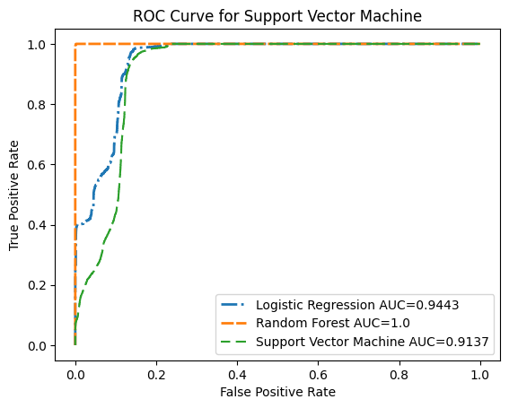
ROC-AUC Curve
ROC Curve
ROC is the receiver operating characteristic curve displaying the performance of classification models at all thresholds.
AUC metric provides an aggregate measure of all evident classification thresholds
 | Logistic Regression | Random Forest | Support Vector Machine
AUC | 0.9443 | 1.0 | 0.9173
Notes:
https://developers.google.com/machine-learning/crash-course/classification/roc-and-auc#:~:text=An%20ROC%20curve%20(receiver%20operating,model%20at%20all%20classification%20thresholds.
Threshold is 1 at (0,0) lowers as it goes up
ROC AUC curve for all models.
ROC - ROC is a probability curve and AUC represents the degree or measure of separability. It tells how much the model is capable of distinguishing between classes. Higher the AUC, the better the model is at predicting 0 classes as 0 and 1 classes as 1.
ROC curve shows how. Much model is capable of distinguishing between classes
Ecelleent model has AUC near 1 which means good measure of separability.
- predicting 0s and 1s, ,and 1s as 0s, it has learned wrong
High AUC indicates the model is able to distinguish between positive and negative classes
True positive rate is proportion of observations that were correctly predicted to be positive out of all positive observations
False positive rate is incorrectly predicted as positive out of all
ROC curve shows the trade off between TPR (sensitivity) and FPR (1- specificity)
https://www.youtube.com/watch?v=egTNM8NSa2k&t=8s
ROC Curves can be used to show accuracy of diagnostic test
100% sensitivity and 100% specificty

Slide 14
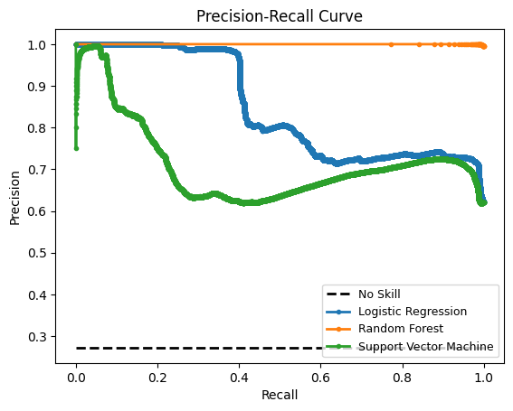
Precision-Recall Curves
Precision – Recall curves show model performance while accounting for an imbalanced dataset
Tradeoff between precision and recall for different thresholds
Precision refers to predicting only relevant cases
Recall refers to predicting all relevant cases
 | Logistic Regression | Random Forest | Support Vector Machine
F1 | 0.764 | 0.997 | 0.765
AUC | 0.847 | 1.000 | 0.715
Notes:
Precision - the quality of a positive prediction made by the model
Recall – all relevant cases
Precision – only relevant cases
Precision-Recall curves summarize the trade-off between the true positive rate and the positive predictive value for a predictive model using different probability thresholds.
ROC curves are appropriate when the observations are balanced between each class, whereas precision-recall curves are appropriate for imbalanced datasets.
x = recall = tp/tp+fn.
Precision = TP/TP+FP Threshold is shown
https://www.youtube.com/watch?v=fF0MvCPsEp8&t=5s
A no skill line shows a classifier that could not discriminate between the classes and would predict at a random or constant class
High precision relates to a low false positive rate – amount of true positive predictions out of all positive predictions
High recall relates to a low false negative rate – amount of tp predictions out of all real positive predictions

Slide 15
Conclusions
All the predictor models all performed well, but Random Forest performed the best
By utilizing time series analysis and feature engineering, any input data from an accelerometer can be predicted on
The binary classification algorithm is ready to be utilized with a smart watch.
Algorithm can be used for:
Eating recognition
Behavioral biometric models for a specific subject
Notes:
By utilizing time series analysis and feature engineering, we can take any dataset from an accelerometer and detect one specific activity out of all occurring
The Support Vector Machine is successfully able to:
Read a large dataset
Strengthen the dataset by sliding a window through it and feature engineering as the data is read
Reduce magnanimous data size- allowing algorithm to run quicker and perform more efficiently
Uptake new prediction data and feature engineer to evaluate whether eating action is occurring or not
Adjust to different devices with variable Hertz and seconds parameters
This algorithm can be implemented into any wearable device with an accelerometer
Algorithm can be used for:
Eating recognition
Behavioral biometric models for a specific subject

Slide 16
Next Steps
New data can be ingested to get better results
Create a Server/Client Algorithm to actively get data to send through ML model
Classify eating activities in Real-time
Train model on gyroscope and magnetometer data to see if positive results hold

Slide 17

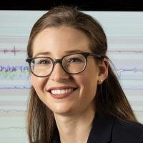
Collaborated with Dr. Jessilyn Dunn and Lucy Chikwetu
Lucy Chikwetu
PhD Student, Duke University
Jessilyn Dunn
Assistant Professor, Duke University
Thank You
Notes:
I worked with Dr. Dunn who welcomed me to the big ideas lab and guided me through this project. And Lucy Chikwetu, who gave me specific advice on the process and mentored me along the way.

Slide 18
References
[1] Gandhi, Rohith. “Support Vector Machine - Introduction to Machine Learning Algorithms.” Medium, Towards Data Science, 5 July 2018, https://towardsdatascience.com/support-vector-machine-introduction-to-machine-learning-algorithms-934a444fca47.
[2] UCI Machine Learning Repository: WISDM Smartphone and Smartwatch Activity and Biometrics Dataset Data Set, https://archive.ics.uci.edu/ml/datasets/WISDM+Smartphone+and+Smartwatch+Activity+and+Biometrics+Dataset+.
[3] Noble, William S. “What Is a Support Vector Machine?” Nature News, Nature Publishing Group, https://www.nature.com/articles/nbt1206-1565.
[4] Noble, William S. “What Is a Support Vector Machine?” Nature News, Nature Publishing Group, https://www.nature.com/articles/nbt1206-1565.
[5] Code Studio, https://www.codingninjas.com/codestudio/library/sliding-window.
[6]] Yiu, Tony. “Understanding Random Forest.” Medium, Towards Data Science, 29 Sept. 2021, https://towardsdatascience.com/understanding-random-forest-58381e0602d2.
[7] Bento, Carolina. “Multilayer Perceptron Explained with a Real-Life Example and Python Code: Sentiment Analysis.” Medium, Towards Data Science, 30 Sept. 2021, https://towardsdatascience.com/multilayer-perceptron-explained-with-a-real-life-example-and-python-code-sentiment-analysis-cb408ee93141#:~:text=A%20Multilayer%20Perceptron%20has%20input,use%20any%20arbitrary%20activation%20function.
Notes:
Here are my refernces and access to the github repository.
Zero values are constant velocity.
Accelerometers measure increase (positive) in velocity and decrease in velocity (negative)

Slide 19
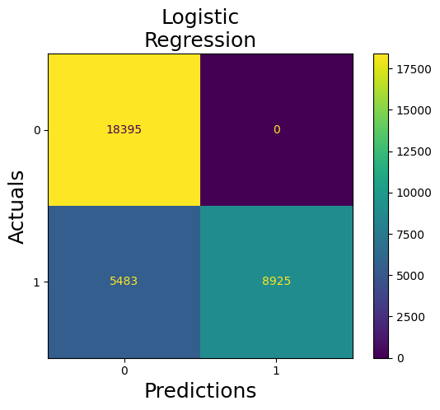
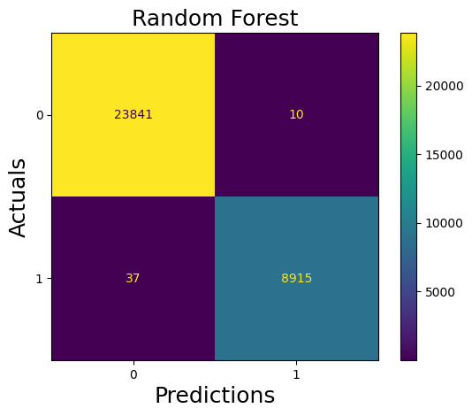
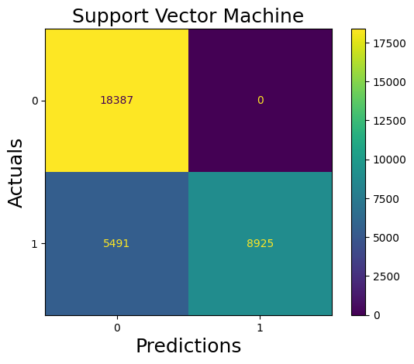
Confusion Matrices

Slide 20
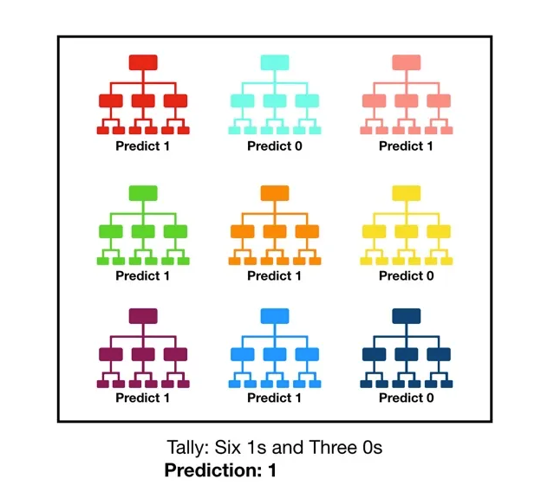
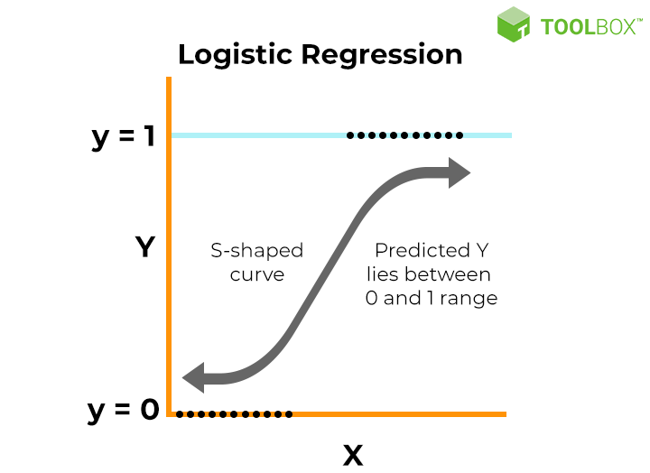
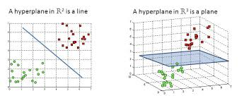
Approach - Model Visual Representations
Random Forest
Logistic Regression
Support Vector Machine
[8]
[7]

Slide 21
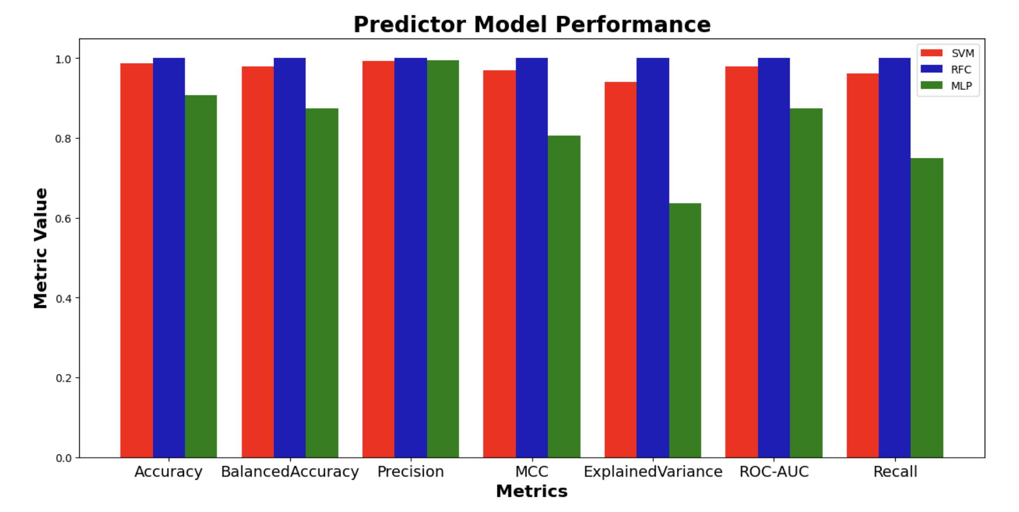
Results - SVM, RF, MLP Performance
Accuracy: Fraction of correct predictions
Balanced Accuracy: Fraction of accurate predictions when accounting for data imbalances
Precision: Fraction of correct positive (1) predictions of all positive predictions
Matthews Correlation Coefficient (MCC): Fraction displaying how well each class is represented.
Explained Variance: Quantifies how well model explains variation in data.
ROC-AUC: Quantifies how well the classifier distinguishes between positive and negative classes
Recall: Fraction of predicted true positive samples out of total existing positive samples.
Notes:
Precision is number of correct positive predictions out of all positive predictions
MCC- Helps us identify the effectiveness of the classiifier in classifying especially negative class samples. Ranges from -1, to 1,
ROC AUC of 0.5 means it is randomly guessing the class, ranks a random positive example higher than a random negative example 50% of the time.
Recall = TP/(FN +TP)

Slide 22
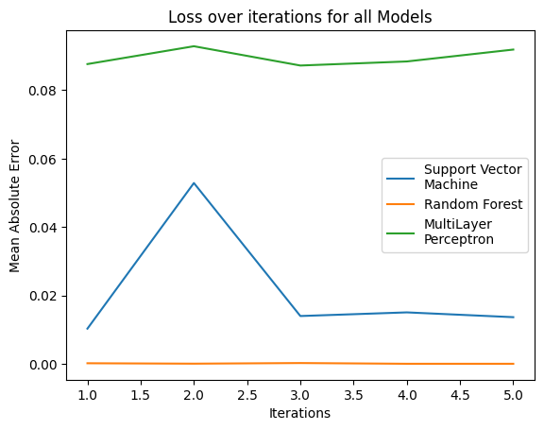
Results - Loss
Mean Absolute Error: Average difference between calculated values and actual values
0.00015
0
Notes:
Maybe switch to cross entropy loss

